Slide 1
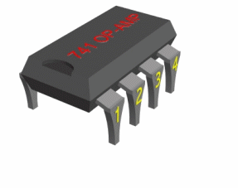
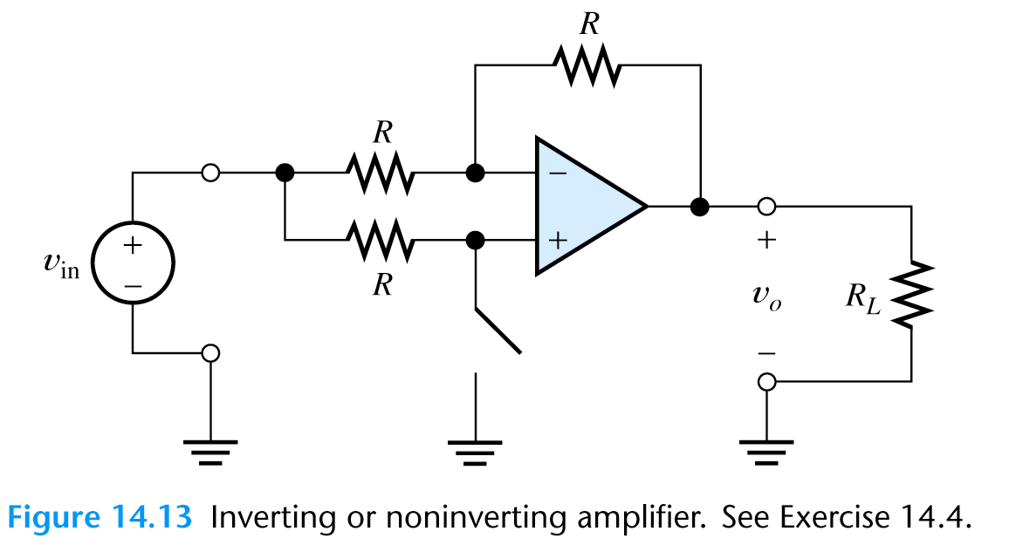
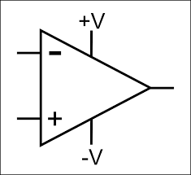
Amplifiers &
Operational Amplifiers

Slide 2
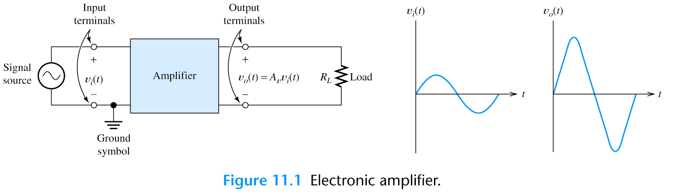
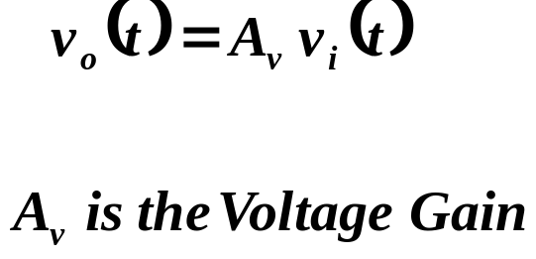
Amplifiers – Basic Amplifier Concepts
Ideally, an amplifier produces an output signal with identical wave-shape as the input signal but with a larger amplitude.

Slide 3
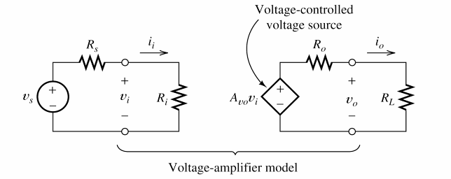
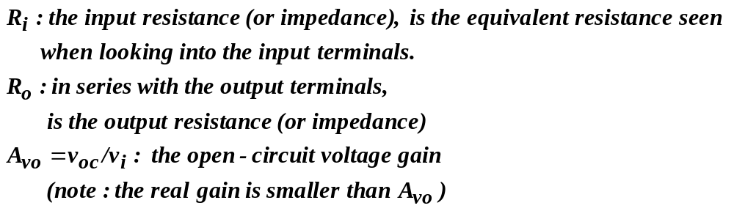
Amplifiers – Amplifier Model
Amplification can be modeled by a controlled source.

Slide 4
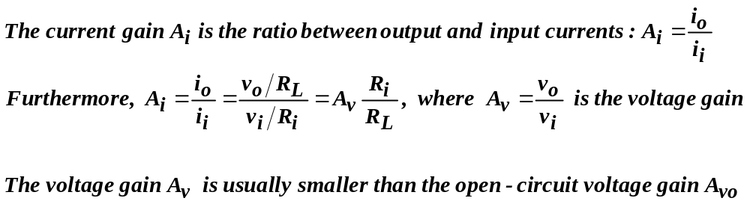
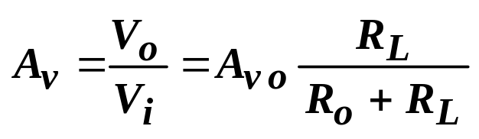
Amplifiers – Current and Voltage Gains
i_{i} is the current delivered in to the terminals of the amplifier;
i₀ is the current flowing through the load

Slide 5
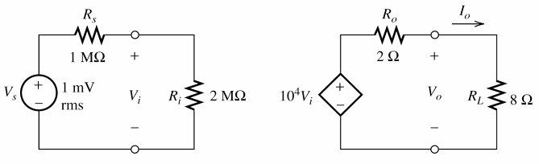
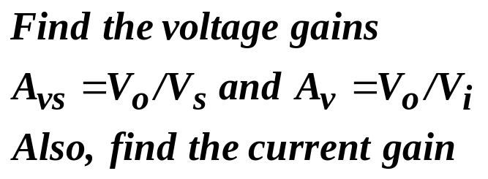
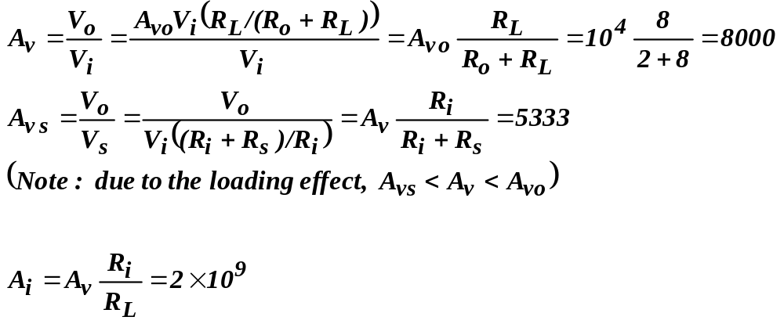
Example

Slide 6
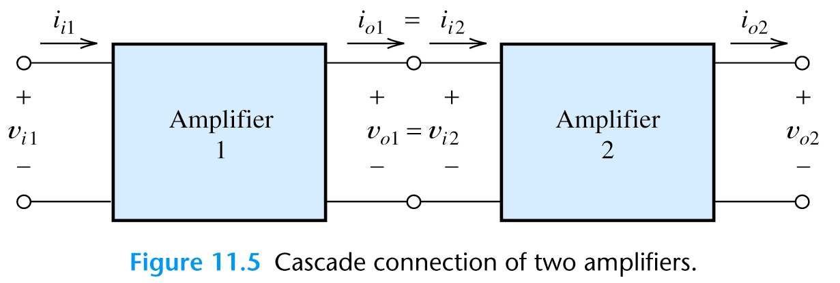
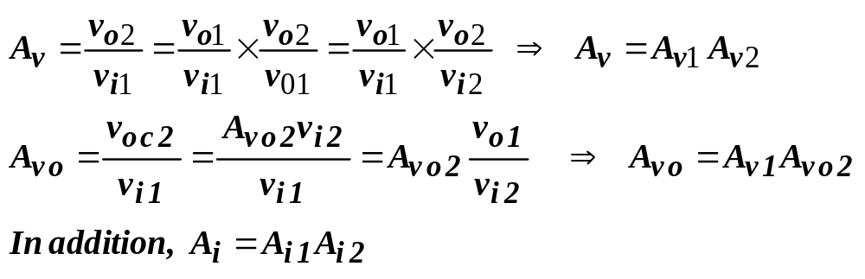
Amplifiers – Cascade Amplifiers

Slide 7
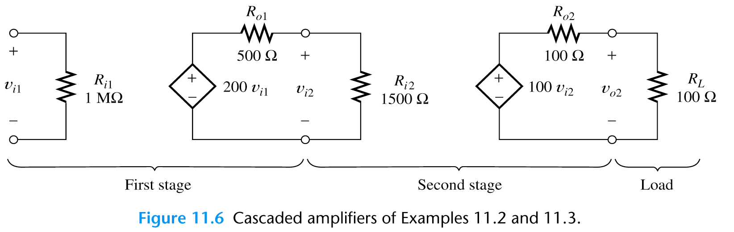

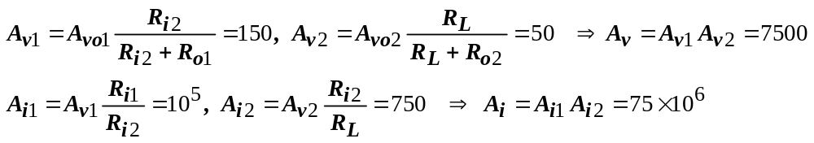
Example

Slide 8
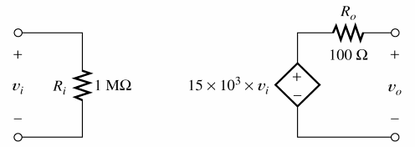
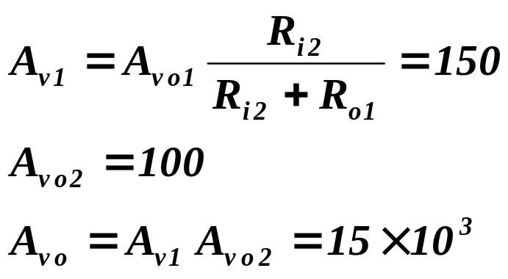
Example

Slide 9
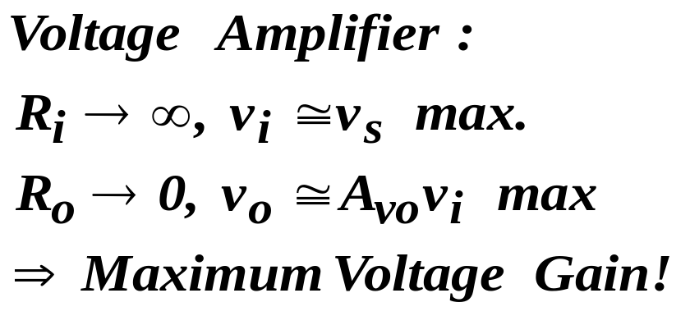
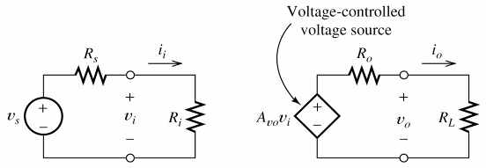
Amplifiers – Ideal Amplifiers

Slide 10
Operational Amplifiers

Slide 11
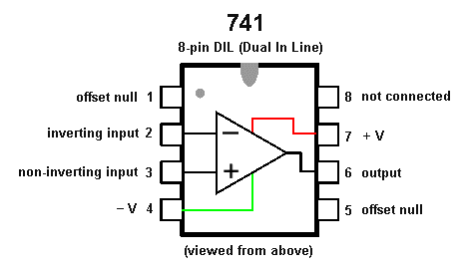
Operational amplifiers (op-amps)
741 Amplifier is the most popular amplifier it has
A_{OL}=100000 (openvoltage gain)

Slide 12
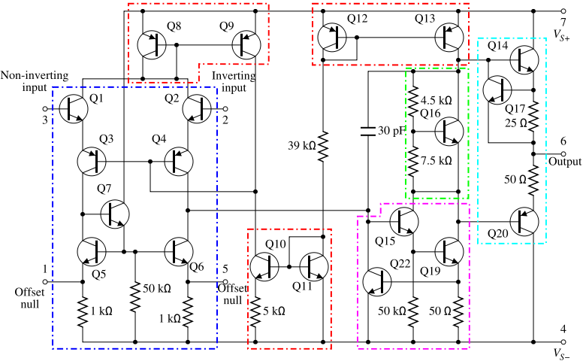
Operational amplifiers (op-amps)
741 Amplifier BJT transistor level schematic

Slide 13
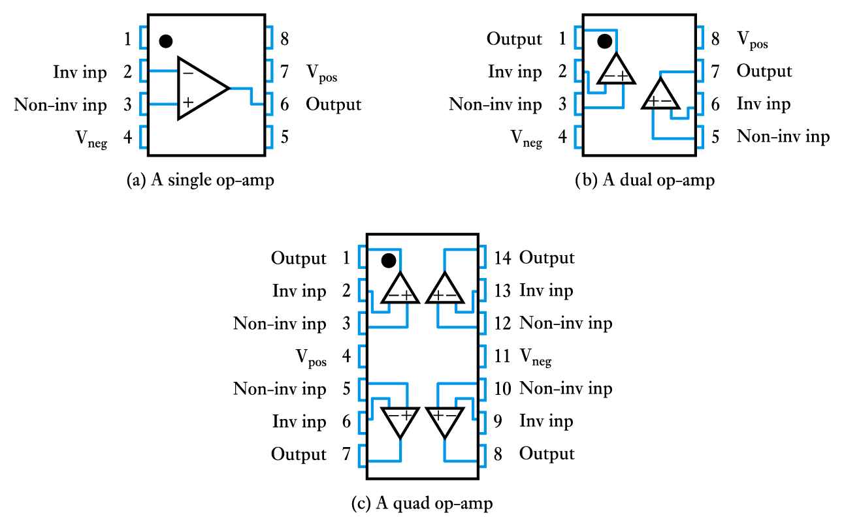
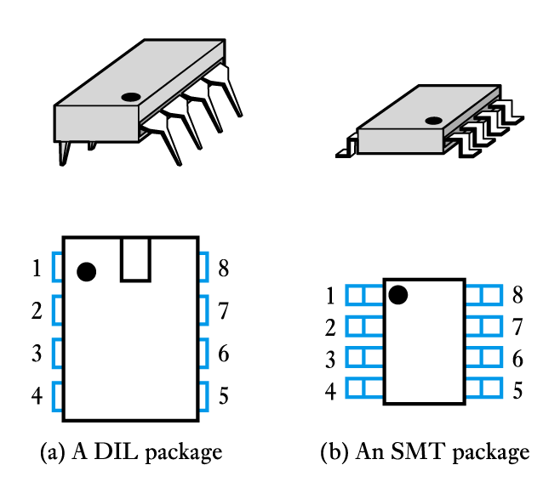
Operational amplifiers (op-amps) are among the most widely used building blocks in electronics.
They are integrated circuits (ICs).
A single package will often contain several op-amps

Slide 14
Operational Amplifier Model
An operational amplifier circuit is designed so that
  V_{out} = A_{v} (V₁-V₂) (A_{v} is a very large gain)
  Input resistance (R_{in}) is very large
  Output resistance (R_{out}) is very low
V₁
R_{out}
V_{out}
R_{in}
+
A_{v}(V₁- V₂)
-
V₂

Slide 15
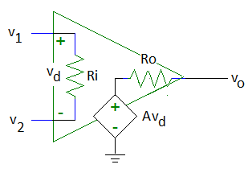
Op Amp Equivalent Circuit
v_{d} = v₂ – v₁
A is the open-loop voltage gain
Voltage controlled voltage source

Slide 16
Typical Op Amp Parameters
Parameter | Variable | Typical Ranges | Ideal Values
Open-Loop Voltage Gain | A | 10⁵ to 10⁸ | ∞
Input Resistance | Ri | 10⁵ to 10¹³ Ω | ∞ Ω
Output Resistance | Ro | 10 to 100 Ω | 0 Ω
Supply Voltage | Vcc/V⁺ -Vcc/V⁻ | 5 to 30 V -30V to 0V | N/A N/A

Slide 17
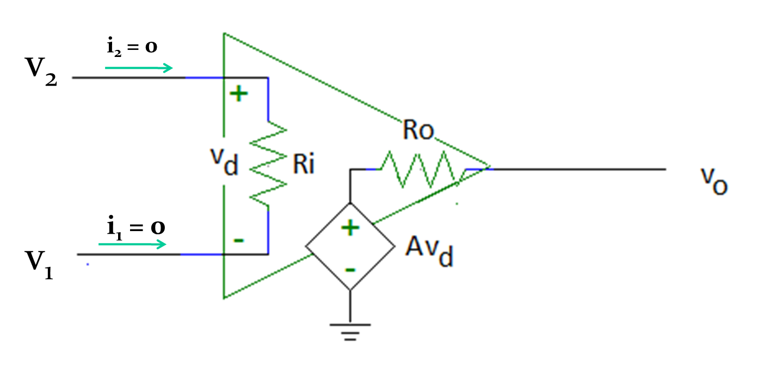
An Ideal Operational Amplifier
Ri = ∞
Therefore, i₁ = i₂ = 0A
Ro = 0

Slide 18
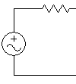
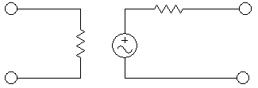
Impedances
Why do we care about the input and output impedance?
Attach an input - a source voltage V_{S} plus source impedance R_{S}
R_{S}
R_{OUT}
V_{IN}
R_{IN}
AV_{IN}
V_{OUT}
V_{S}
Note the voltage divider R_{S} + R_{IN}.
  V_{IN}=V_{S}(R_{IN}/(R_{IN}+R_{S})
  We want V_{IN} = V_{S} regardless of source impedance
  So want R_{IN} to be large.
The ideal amplifier has an infinite input impedance

Slide 19

Impedances
Attach a load - an output circuit with a resistance R_{L}
R_{S}
R_{OUT}
V_{IN}
R_{IN}
AV_{IN}
V_{OUT}
R_{L}
V_{S}
Note the voltage divider R_{OUT} + R_{L}.
  V_{OUT}=AV_{IN}(R_{L}/(R_{L}+R_{OUT}))
  Want V_{OUT}=AV_{IN} regardless of load
  We want R_{OUT} to be small.
The ideal amplifier has zero output impedance

Slide 20
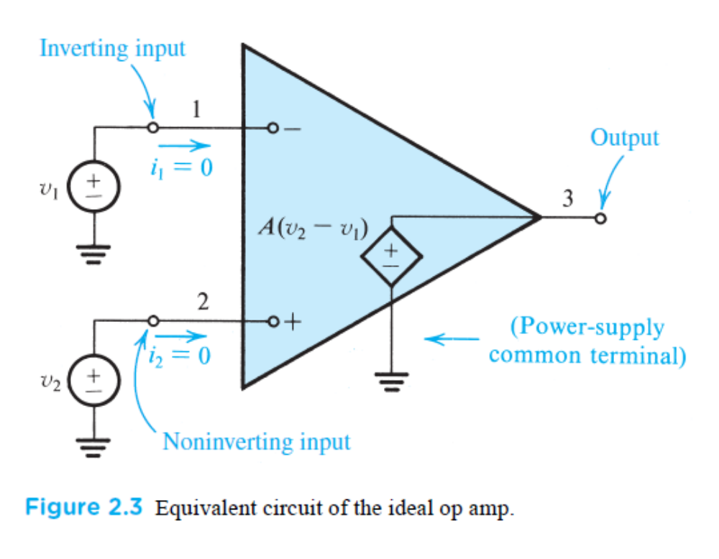
An Ideal Operational Amplifier

Slide 21
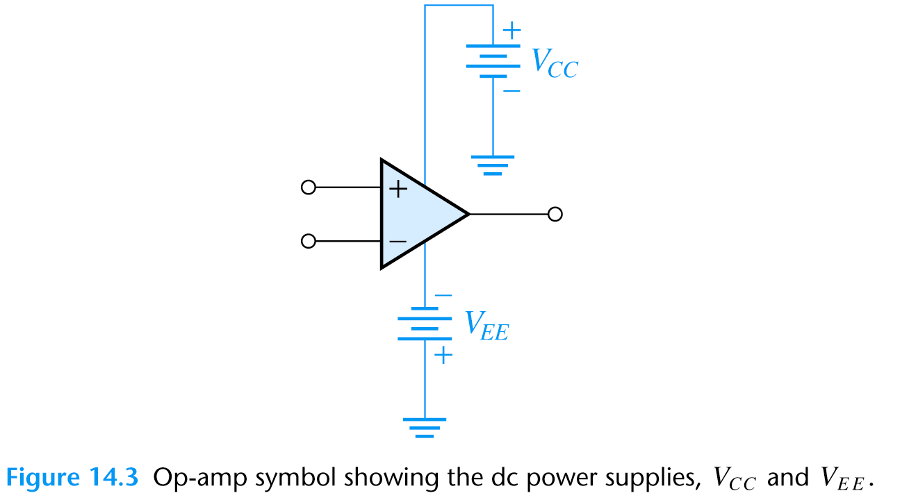
An Ideal Operational Amplifier
A real op-amp must have a DC supply voltage which is often not shown on the schematics

Slide 22
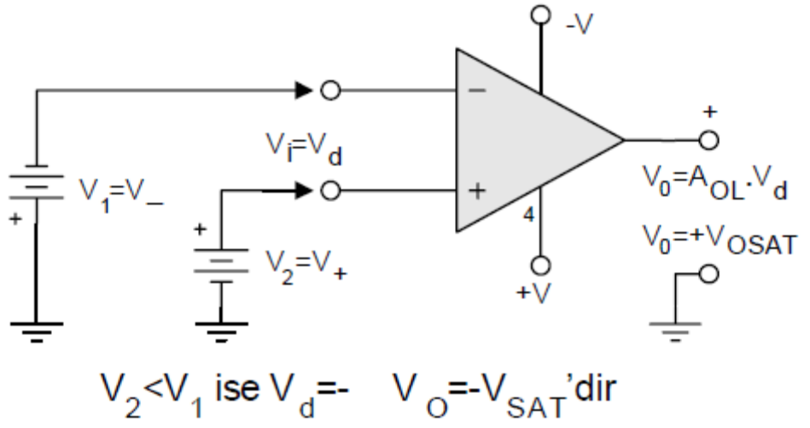
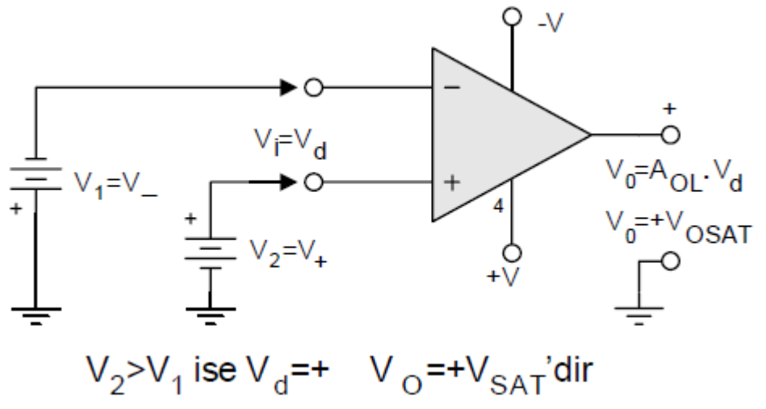
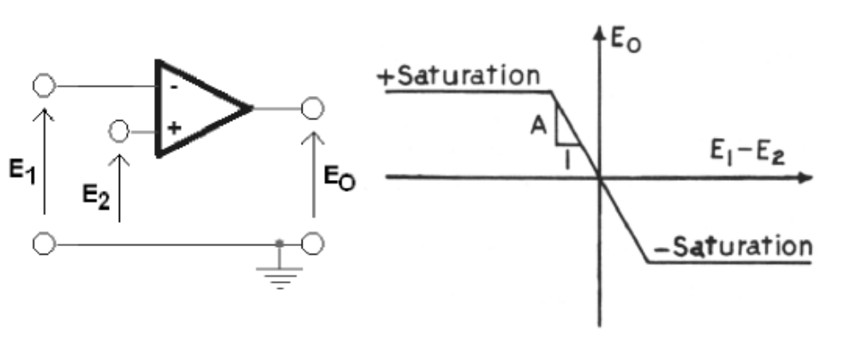
Op-amps
Output voltage of an Op-amp can not be greater than DC supply voltage.
Maximum output voltage is usually slightly lower than the DC supply voltage and called as saturation voltage.

Slide 23
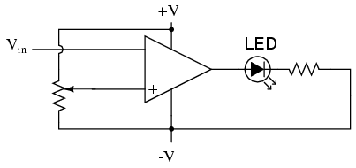

Comparator
V₁
V_{out}
V₂
Applications: Low-voltage alarms, night light controller

Slide 24
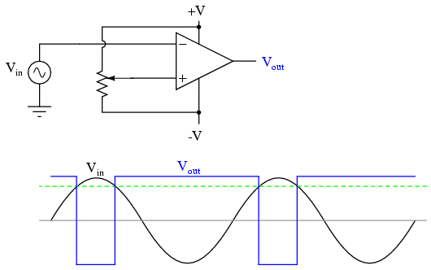
Pulse Width Modulator
Output changes when V_{in} ~= V_{pot}
  V_{pot}
  +V_{sat}
  V_{pot}
  -V_{sat}
Application: Motor controllers

Slide 25
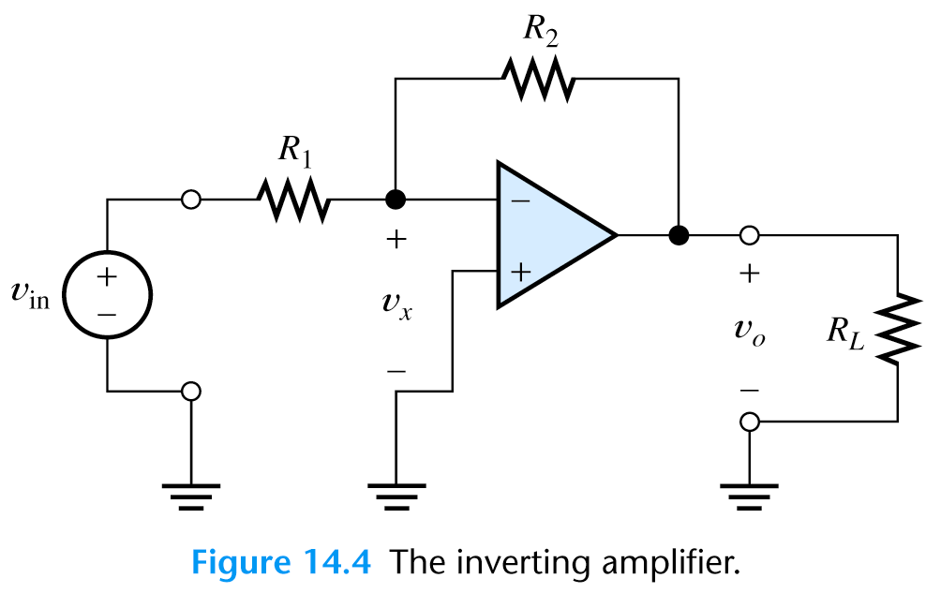
Negative feedback
Op-amp are almost always used with a negative feedback:
Part of the output signal is returned to the input
Feedback reduces the gain of op-amp.
  Negative feedback forces the voltage at the inverting input terminal to be equal to the voltage at the noninverting input terminal.
i₂
i₁

Slide 26
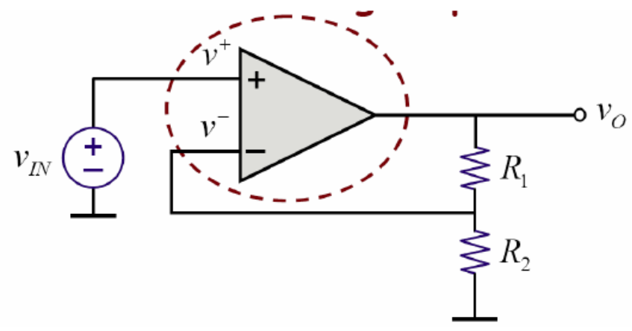
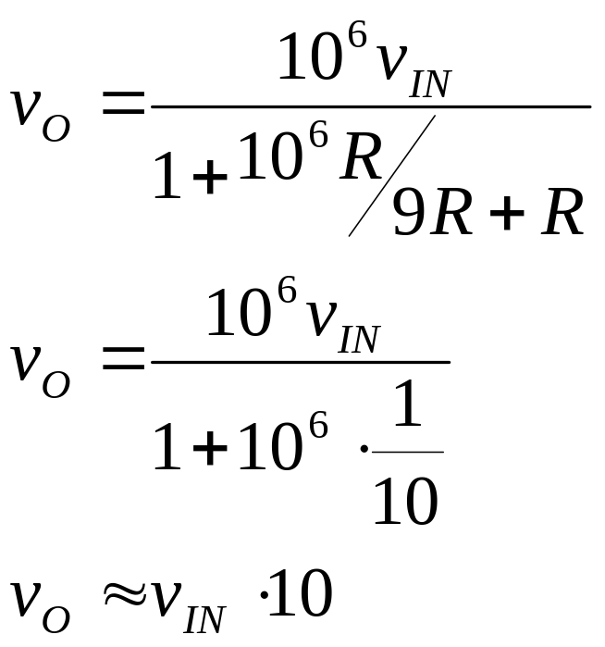

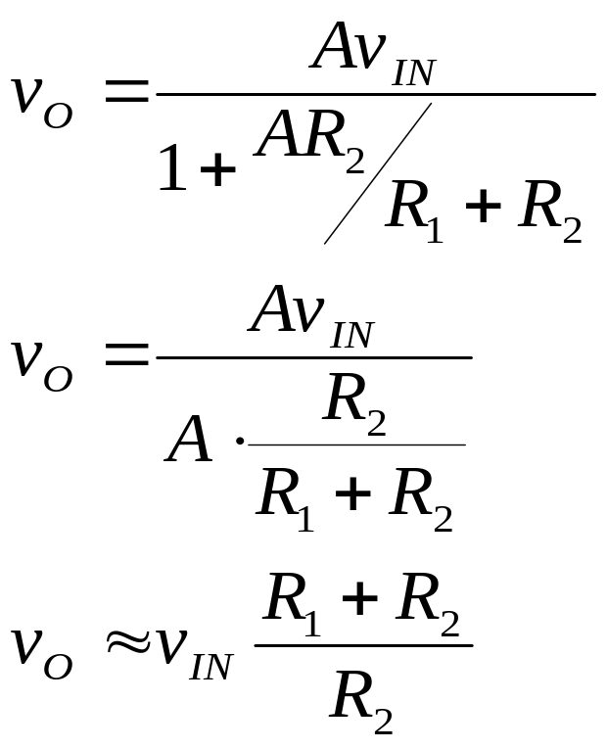
When A is very large:
Take A=10⁶, R₁=9R, R₂=R
>>1
Gain now determined only by resistance ratio
Doesn’t depend on A, (or temperature, frequency, variations in fabrication)

Slide 27
Why use Negative feedback?:
Helps to overcome distortion and non-linearity
Improves the frequency response
Makes properties predictable - independent of temperature, manufacturing differences or other properties of the opamp
Circuit properties only depend upon the external feedback network and so can be easily controlled

Slide 28
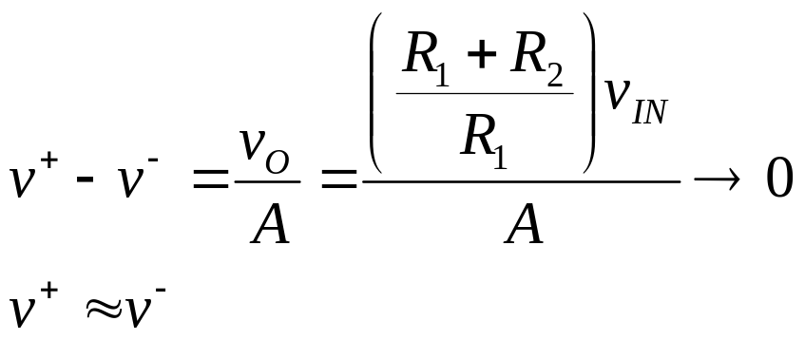
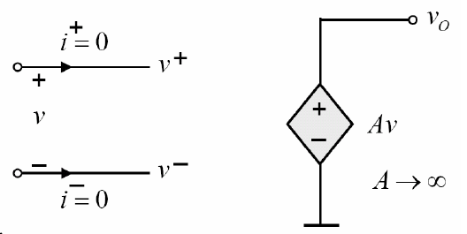
More insight
Under negative feedback:
We also know
  i⁺ ≈ 0
  i⁻ ≈ 0
Helpful for analysis (under negative feedback)
Two "Golden Rules«
1) No current flows into the op-amp
2) v⁺ ≈ v⁻

Slide 29
Inverting Amplifier
Since negative feedback forces the voltage at the inverting input terminal (v₋) to be equal to the voltage at the noninverting input terminal (v₊), v_{x} is equal to zero.
v₋= v₊=0V
i₁ = v_{in} /R₁
i₂ = i₁ and
v_{o} = -i₂ R₂ = -v_{in} R₂ /R₁
So
A_{v}=v_{o} /v_{in} =-R₂ /R₁
i₂
i₁

Slide 30
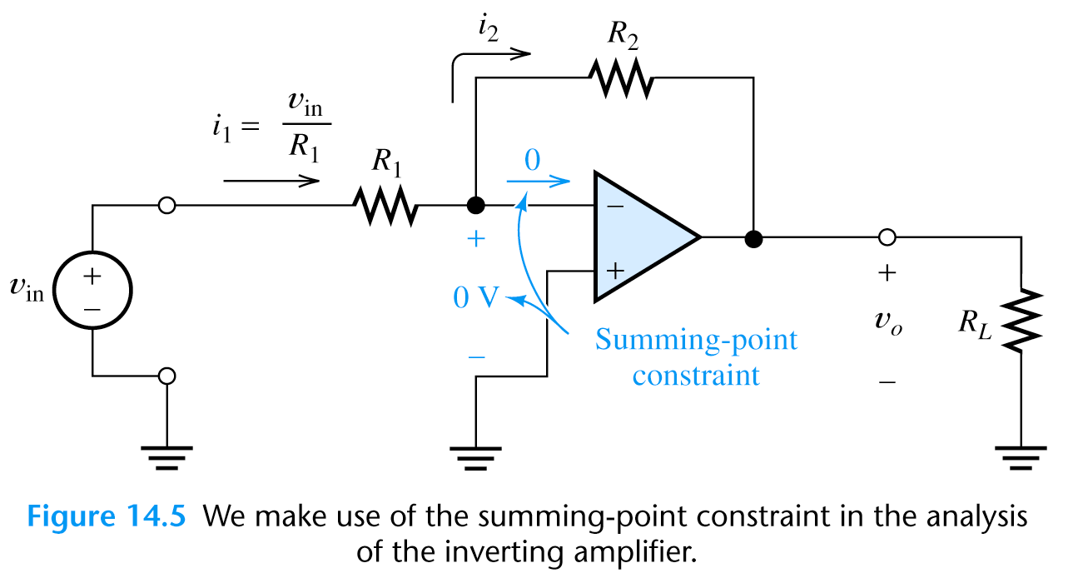
Inverting Amplifier
Since v_{o} = -i₂ R₂ = -v_{in} R₂ /R₁
We see that the output voltage does not depend on the load resistance and behaves as voltage source.
The output impedance of the inverting amplifier is zero.
The input impedance is: Z_{in}=v_{in}/i₁=R₁

Slide 31
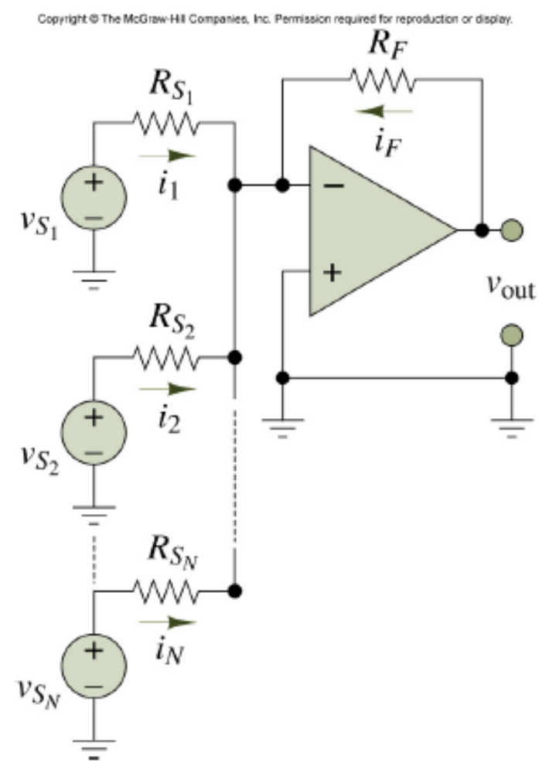
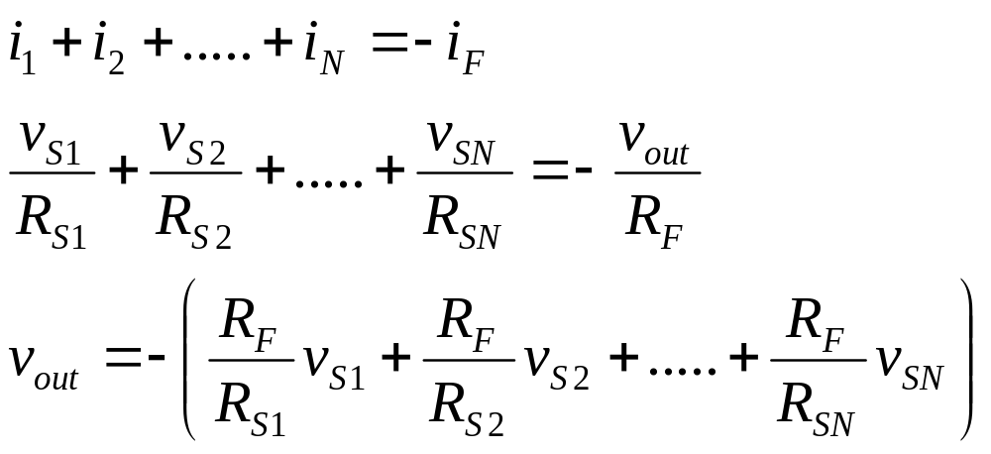
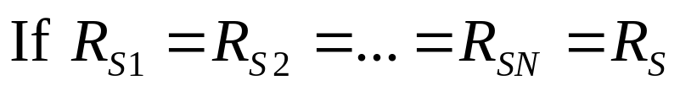
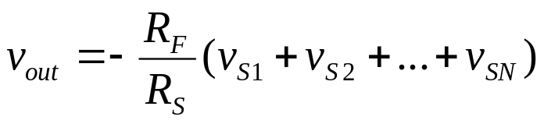
Summing Amplifier
The output voltage in summing amplifier is
v_{out}=i_{f}*R_{f} since v₋=v₊=0

Slide 32
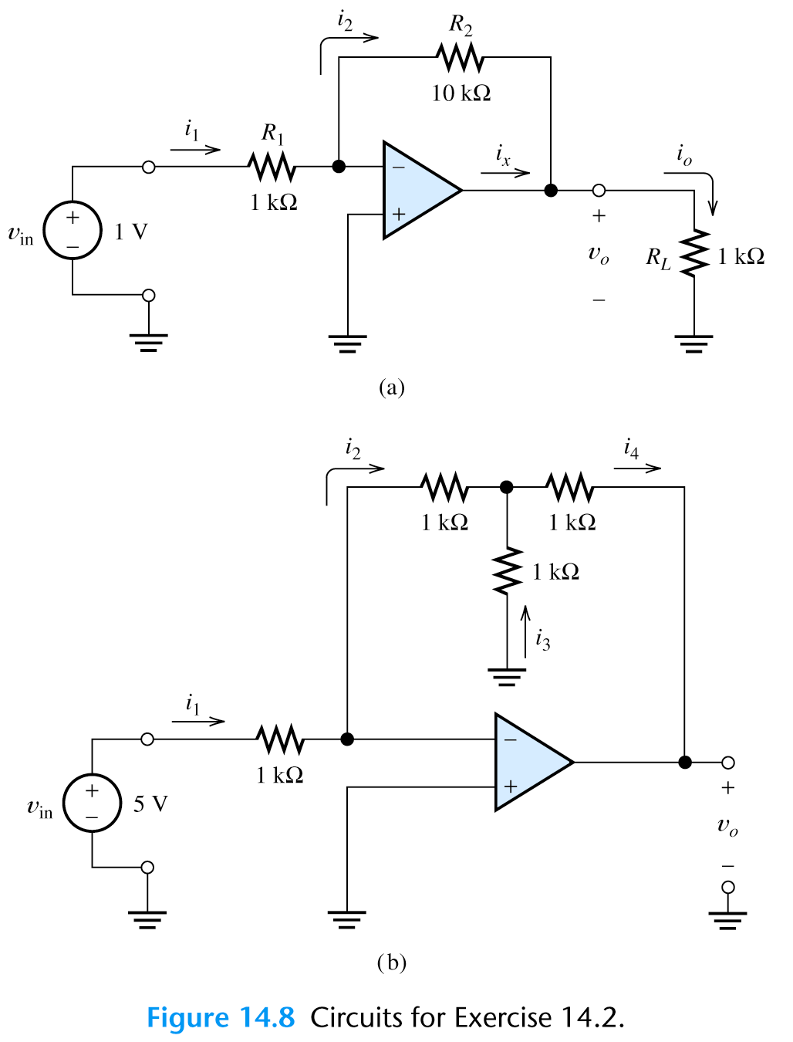
Exercise
Find the currents and voltages in these two circuits:
a) i₁=v_{in}/R₁=1V/1k Ω =1mA
i₂=i₁=1mA from KCL
v_{o}=-i₂*R₂=-10V from KVL
i_{o}=v_{o}/R_{L}=-10mA from Ohms law
i_{x}=i_{o}-i₂=-10mA-1mA=-11mA
b) i₁=v_{in}/R₁=5mA
i₂=i₁=5mA
i₂*1kΩ= i₃*1kΩ => i₃=5mA
i₄=i₂+i₃=10mA
v_{o}=- i₂*1k Ω - i₄*1k Ω =-15 V
R₁

Slide 33
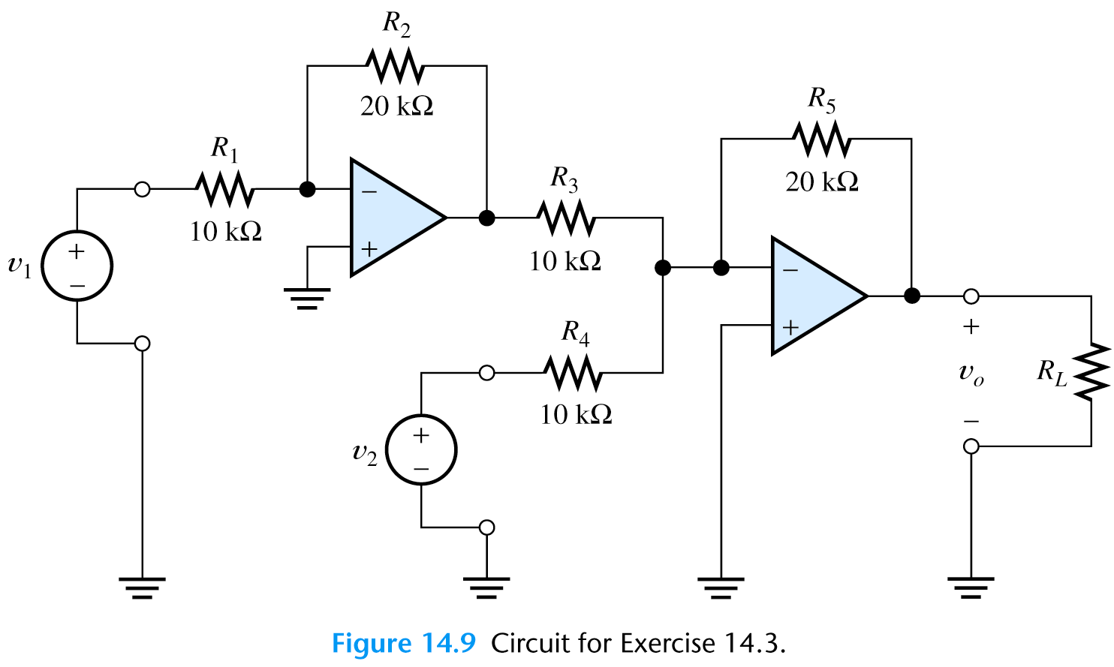
Exercise
Find expression for the output voltage in the amplifier circuit:
i₂
i₅
i₁
V₃
i₃
i_{L}
i₄
i₁=v₁/R₁=v₁/10k Ω
i₂=i₁=v₁/10mA
v₃ =- i₂*R₂=- v₁/10k Ω *20k Ω =-2v₁
i₅=i₃+i₄=v₃/10k Ω +v₂/10k Ω
v_{o} =- i₅*R₅=-(v₃/10k Ω +v₂/10k Ω )*20k Ω =-2v₃ -2v₂ =4v₁ -2v₂

Slide 34
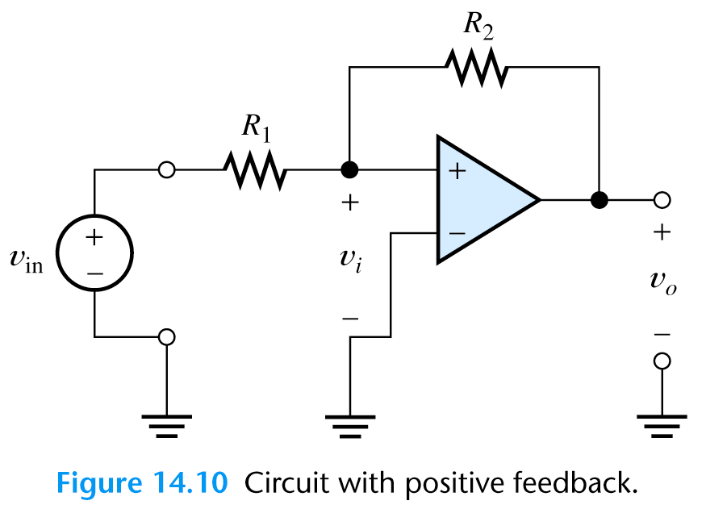
Positive Feedback
When we flip the polarization of the op-amp as shown on the figure we will get a positive feedback that saturates the amplifier output.
This is not a good idea.

Slide 35
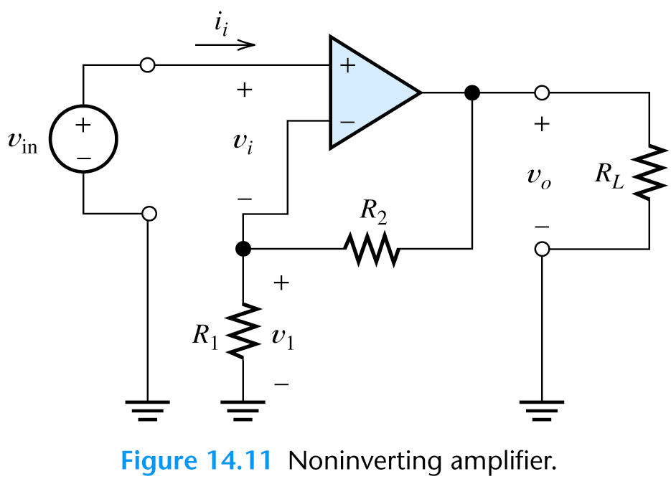
Noninverting Amplifier
v₁=v_{in}
i₁=v₁/R₁
i₂=-i₁
v_{o} = v₁ - i₂*R₂= v₁ + i₁*R₂ =
= v₁ + v₁/R₁ *R₂=v₁*(1+ R₂ /R₁)
Thus the voltage gain of noninverting amplifier is:
A_{v}= v_{o} /v_{in} = 1+ R₂ /R₁
i_{L}
-i₁
i₂

Slide 36

Voltage Follower
What's the application of this circuit?
Buffer
  voltage gain = 1
  input impedance=∞
  output impedance=0
Useful interface between different circuits:
Has minimum effect on previous and next circuit in signal chain

Slide 37



Differential Amplifier (subtractor)

Slide 38

Differential Amplifier applications
Very useful if you have two inputs corrupted with the same noise
Subtract one from the other to remove noise, remainder is signal

Slide 39
Exercise
Find voltage gain A_{v}=v_{o}/v_{in} and input impedance
With the switch open
With the switch closed
i₁
i₁
i₂
a. From KVL: v_{in}=i₁*R+i₁*R+v_{o}
i₂=0 and i₁*R=i₂*R => i₁=0
so v_{in}=v_{o} and A_{v}=v_{o}/v_{in} =1
Input impedance:
Z_{in}=v_{in}/i_{in} =v_{in}/0 =inf

Slide 40
Exercise
Find voltage gain A_{v}=v_{o}/v_{in} and input impedance
With the switch open
With the switch closed
b. for closed switch: i₂=v_{in}/R
and i₁*R=i₂*R => i₁=i₂ => v_{in}=i₁*R+i₁*R+v_{o}
so v_{in}=v_{in}/R*R+v_{in}/R*R+v_{o} => -v_{in}=v_{o}
and A_{v}=v_{o}/v_{in} =-1
i₁
i₁
i₂

Slide 41
Exercise
Find voltage gain A_{v}=v_{o}/v_{in} and input impedance
With the switch open
With the switch closed
b. i₂=v_{in}/R
Input impedance: Z_{in}=v_{in}/i_{in} =v_{in}/(i₁+i₂)
and i₁=i₂ =>
Z_{in}=v_{in}/i_{in} =v_{in}/(2*v_{in}/R)=R/2
i₁
i₁
i₂

Slide 42

Voltage to Current Converter
Find the output current i_{o} as a function of v_{in}
v_{in} =i_{o}*R_{f}
so
i_{o}=v_{in}/R_{f}

Slide 43

Exercise
Find the voltage gain v_{o}/v_{in}
Calculate the voltage gain v_{o}/v_{in} for R₁=10 kW, R₂ = 100 kW
Find the input resistance

Slide 44
Exercise
Find the voltage gain v_{o}/v_{in}
Calculate the voltage gain v_{o}/v_{in} for R₁=10 kW, R₂ = 100 kW
Find the input resistance
From KCL1: v_{in}/R₁ =(v₂-v_{in})/R₂ => v₂= v_{in} (1+ R₂ /R₁)
From KCL2: (v₂-v_{in})/ R₂ +v₂/R₁+(v₂-v₀)/ R₂ =0 =>
v₀=(v₂-v_{in}) +v₂R₂/R₁+v₂ =>
v₀ / v_{in} =131
v₂

Slide 45



Op-amp integrator
V
V_{IN}
Integrator response to a constant voltage:
t
V_{OUT}
V
V_{IN}
What's the integrator response to a square wave?
t
V_{OUT}

Slide 46

Differentiating Op-Amp

Slide 47

Design of Simple Amplifiers
Practical amplifiers can be designed using op-amp with feedback.
We know that for noninverting amplifier
Av= v_{o} / v_{in} = 1+ R₂ /R₁
so to obtain Av=10 we could use R1=1Ω and R2=9Ω. But such low output resistance will draw too much current from the power supply.

Slide 48

Design of Simple Amplifiers
The same gain can be obtained with large resistance values.
But for high output resistance are sensitive to bias current and we must use a filtering output capacitor to remove the noise.
A_{v}= v_{o} / v_{in} = 1+ R₂ /R₁

Slide 49


Op-Amp Imperfections in a Linear Mode
We consider the following op-amp imperfections:
Input and output impedances:
Ideal opamp
Real op-amp has

Slide 50


Nonlinear Limitations
Nonlinear limitations:
Output voltage swing is limited and depend on power supply voltage for
Maximum output current is limited

Slide 51

Nonlinear Limitations
When voltage or current limits are exceeded, clipping of the output signal occurs causing large nonlinear distortions

Slide 52





Nonlinear Limitations
Another nonlinear limitation is limited rate of change of the output signal known as the slew-rate limit SR
Using slew rate (SR) we can find maximum frequency known as full-power bandwidth.
Assuming:
So the full-power bandwidth

Slide 53



DC offset values
There are three DC offset values related to op-amp design:
Bias currents I_{B+}, I_{B-} – related to differential inputs
Offset current – ideally zero value
Offset voltage – results in nonzero output for zero input
They can be represented as additional DC sources in the
op-amp model

Slide 54


Resistor to balance the effect of bias currents

Slide 55

Example: Calculate vo

